Slide 1

Research Methods in Sociology
Ms. Kauser Malik
Lecturer (Sciences & Humanities)

Slide 2
Learning Outcomes
Research and theory together in sociology; Common sense vs. Sociological research
Eight steps of the research model
Types of research methods: surveys, participant observation, case studies, secondary analysis, analysis of documents, experiments, and unobtrusive measures; why sociological research can lead to controversy.
Significance of gender in sociological research
Protection of participants in sociological research studies

Slide 3
How research and theory work together
Every theory must be tested, which requires research. Sociologists do research, often coming up with surprising findings, those results must be explained; for that, we need theory.
Notes:
Source: the course book, Sociology-A Down-to-Earth Approach- 13th edition by James. M. Henslin,

Slide 4
Sociology Research Methods
Sociology - the science of society and the humans within it.
A research method is any strategy a researcher uses to collect data.
Research methods provide scientists with a framework for extracting information from individuals, families, small groups or entire cultures. Without well-defined research methods, sociologists would struggle to gather accurate, consistent data.
Several research methods in sociology each with its advantages, drawbacks and ideal use cases.

Slide 5
Microsociology
Humans live and interact in small groups (family, community, ethnic group, ideological group etc.). Microsociology helps us analyze these subsets of the population in greater detail.
It looks at small-scale interactions between individuals, such as conversation or group dynamics, how people interact on street corners and even shyness (Scott 2006).
Helps in understanding the local, personal, and small-scale level affords us a more nuanced understanding of the “big culture”.
Explores local, interpersonal issues on a small scale.

Slide 6
Macrosociology
A sub-field of sociology. ”Macro” means “large”; thus, the term describes the analysis of large scale social phenomena.
Addresses large scale, national, global issues.
E.g., social stability and change, the laws, the military and the global economic crisis (Fligstein and Habinek 2014).

Slide 7
Common Sense vs. Sociological Research
Common Sense promotes stereotypical beliefs but sociology uses reason and logic.
Common sense is based upon assumptions while sociology is based upon evidences.
Empirical testing has no place in common sense knowledge whereas Sociology pursue research with an empirical orientation.

Slide 8
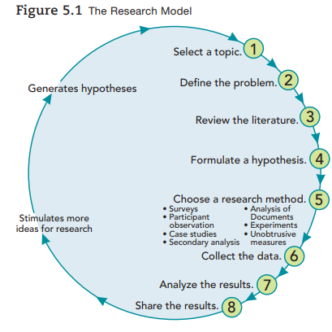
Steps of the research model
Scientific research follows eight basic steps. In the real world of research, some of these steps may run together. Some may even be omitted.

Slide 9
Steps of Research Model
1. Topic Selection
2. Problem Definition
3. Literature Review
4. Hypothesis Formulation
5. Choosing a research method
6. Data Collection
7. Result Analysis
8. Dissemination of results

Slide 10

1. Selecting a topic
What do you want to know more about?
Curiosity
To learn more about social life
Interest in a particular topic
Some sociologists choose a topic because funding is available, others because they want to help people better understand a social problem and perhaps to help solve it.
E.g.: studying the homeless, spouse abuse

Slide 11

2. Define the problem
To specify what you want to learn about the topic.
Example: examining some specific aspect of a topic, such as how homeless people survive on the streets.
In the case of spouse abuse, sociologists may want to know whether violent and nonviolent husbands have different work experiences. Or they may want to learn what can be done to reduce spouse abuse.

Slide 12

3. Reviewing the literature
Reading what has been published on the topic.
This helps to narrow the problem, identify areas that are already known, and learn what areas need to be researched.
Reviewing the literature may also help to pinpoint the research questions that would be addressed.
A possibility that the research question has been answered already.
In reviewing the existing research, note problems that have come up to avoid repeating past mistakes.

Slide 13

4. Formulating a hypothesis
A research hypothesis is a statement of expectation or prediction that will be tested by research.
A statement of what you expect to find according to predictions from a theory.
A hypothesis predicts a relationship between or among variables, factors that change, or vary, from one person or situation to another.
For example, the statement “Men who are more socially isolated are likelier to abuse their wives than men who are more socially integrated” is a hypothesis.
Hypothesis will need operational definitions (precise ways to measure the variables).

Slide 14

5. Choosing a research method
How you are going to collect your data
Choose the research method that will best answer your particular questions. Consider all major research strategies, as well as combinations of methods. the best method depends on the kind of questions being asked asking as well as the available resources.

Slide 15

6. Collecting the data
How will you record the data?
The research method is a plan for data collection. Record all information accurately
Which definition will you choose? - To assure the data’s validity (accuracy), the operational definitions must measure what they are intended to measure.
E.g., spouse abuse, seems to be obvious. Yet what some people consider abusive is not regarded as abuse by others.
Data must be reliable.
Reliability means that if other researchers use your operational definitions, their findings will be consistent with yours.

Slide 16

7. Analyzing the results
What do the data tell you and what are your conclusions?
Study the data in terms of initial questions and decide how to interpret the data collected.
Prepare a final report stating the conclusions.
Microcase and SPSS (Statistical Package for the Social Sciences).
Some software, such as the methodologist’s Toolchest, provides advice about collecting data and even about ethical issues.

Slide 17

8. Sharing the results
How can you share what you’ve learned?
A report to share findings with the scientific community.
Review of how the research was conducted and specify the operational definitions.
Compare findings with published reports on the topic and examine how they support or disagree with theories that others have applied.

Slide 18

elements in research

Slide 19
Validity & Reliability
Validity
refers to the accuracy of a study's findings and their ability to truly reflect the phenomenon being investigated. It ensures that the study is measuring what it intends to measure, leading to trustworthy conclusions.
Reliability
Reliability in research is a concept describing how reproducible or replicable a study is. In general, if a study can be repeated and the same results are found, the study is considered reliable.
Reliability increases the likelihood that what happens to one person will happen to all people in a group.
Notes:
http://www.csun.edu/~hbsoc126/soc1/chapter%205%20outline.pdf

Slide 20
Types of data in sociology research
In sociology, researchers often categorize their data into the following four categories:
Primary Data
Secondary Data
Information collected directly by the researcher themselves. Firsthand gathered data
Data collected by a previous sociologist or institution
E.g., data from books, government data or scholarly journals.
E.g., surveys, interviews and observational studies.

Slide 21
Qualitative Data
Quantitative Data
Data that can appear as a number or statistic. Information in numerical form.
Data that can’t be quantified
Such data collected through statistical methods, especially surveys.
E.g., Age and birth rates.
E.g., Stories, opinions, photos and videos are generally qualitative.
Because two of these types of data refer to the information collected and two refer to the way it was collected, all data will fall under two of the above categories. For example, a firsthand account from a fisherman about the number of his typical catches is quantitative and primary.

Slide 22

Common Research Methods in Sociology

Slide 23
Research Methods
A systematic plan for doing research.
Four commonly used methods of sociological investigation are:
Experiment
A research method for investigating cause and effect under highly controlled conditions
Survey
A research method in which subjects respond to a series of statements or questions on a questionnaire or in an interview
Participant Observation
A research method in which investigators systematically observe people while joining them in their routine activities
Use of existing resources
A research method in which a researcher used data already collected by others

Slide 24

Surveys
One of the most used research methods. Involves asking participants to answer relatively simple pre-written questions.
Typically structured questionnaires designed to collect information from large numbers of people in standardized form.
Benefits:
Excellent tools for gathering quantitative (and occasionally qualitative) primary data from large groups of people.
Participants can complete social surveys asynchronously. The sociologist doesn’t even need to be present to obtain results from a questionnaire. If someone in the field can share the survey research with participants, the researcher can save travel time and costs by remaining in the lab. Online questionnaires make data collection even easier.
Can be done privately or even anonymously to ensure results are unbiased.
Well suited to studying what cannot be observed directly, such as political attitudes or religious beliefs.
E.g.: The national census. The census requires participants to self-report their demographic information, which the government uses to determine government representation and how to distribute federal funds to local communities.

Slide 25
Questionnaire: A series of written questions a researcher presents to subjects.
Closed-ended:
questions with a selection of fixed responses (similar to a multiple-choice examination).
makes it fairly easy to analyze the results
by narrowing the range of responses, it can also distort the findings.
Open-ended:
allows subjects to respond freely, expressing various shades of opinion.
drawback - researcher has to make sense out of what can be a very wide range of answers.
The researcher must also decide how to present questions to subjects.
When using a self-administered survey, mailing or e-mailing questionnaires to respondents the questionnaire must be both inviting and clearly written.
Using the mail or e-mail allows a researcher to contact a large number of people over a wide geographic area at minimal expense. But many people who receive such questionnaires treat them as junk mail.

Slide 26

Interviews
A series of questions a researcher asks respondents in person.
In a closed format design, researchers read a question or statement and then ask the subject to select a response from several that are presented.
More commonly, interviews are open-ended so that subjects can respond as they choose and researchers can probe with follow-up questions.
In either case, the researcher must guard against influencing a subject.
Disadvantages:
Tracking people down can be costly and takes time, especially if subjects do not live in the same area.
Telephone interviews allow far greater “reach,” but the impersonality of cold calls by telephone (especially when reaching answering machines) can lower the response rate.

Slide 27
In both questionnaires and interviews, how a question is worded greatly affects how people answer.
For example, if researchers asked U.S. adults if they support our military, a large majority of people said yes. Yet when researchers asked people if they supported what the military was trying to do in Iraq, most said no.
When it comes to survey questions, the exact wording will always affect responses. This is especially true if emotionally loaded language is used. Any words that trigger an emotional response in subjects will sway the results. For instance, using the expression “welfare mothers” rather than “women who receive public assistance” adds an emotional element to a question that encourages people to express a negative attitude.
Another problem is that researchers may confuse respondents by asking a double question, such as “Do you think that the government should reduce the deficit by cutting spending and raising taxes?” The issue here is that a subject could very well agree with one part of the question but not the other, so that forcing a subject to say yes or no distorts the opinion the researcher is trying to measure.
Conducting a good interview means standardizing the technique—treating all subjects in the same way. But this, too, can be problematic. Drawing people out requires establishing rapport, which in turn depends on responding naturally to the particular person being interviewed, as you would in a normal conversation.

Slide 28
Structured Interviews
A one-on-one interaction between a sociologist and a participant that involves pre-approved questions. Either in-person or on a call, the researcher reads the questionnaire to the participant and records their answers.
Structured interviews stick to the closed, pre-written questions on the survey. Ideal for collecting quantitative data, though some qualitative data can come through.
A structured interview can be a better alternative to a social survey if the participant:
Has limited reading or writing skills
Is differently-abled
Prefers a more personable approach
E.g., call from a telemarketer to take a quick survey.
A researcher asking predefined questions to each child in a classroom.

Slide 29
Unstructured Interviews
Also a one-on-one interaction between a sociologist and a participant, but it’s more of a conversation. The researcher will still come prepared with a list of open-ended questions.
Semi-Structured Interviews
A semi-structured interview allows for a mixed approach. The researcher will come with set questions but leave more room for natural conversations. They may also modify their questions on the fly, depending on the trajectory of the interview.
Unstructured interviews are a more natural approach to data collection. They allow participants to lead the conversation and speak comfortably and openly. As a result, most data from unstructured interviews is qualitative—it's based more on descriptions than on numbers.
Unstructured interviews are ideal for more preliminary or exploratory studies of groups or cultures when a field research goal or learning objective has yet to be defined. This research method also reduces researcher bias, as the sociologist’s questions don’t influence the respondent’s answers.
Semi-structured interviews let sociologists collect quantitative and qualitative data from a single conversation. The pre-written questions allow for comparisons between respondents, while the open-ended questions can provide context and insight.

Slide 30
Participant Observation
The most widely used strategy for field study is participant observation, a research method in which investigators systematically observe people while joining them in their routine activities. This method allows researchers an inside look at social life in any natural setting, from a nightclub to a religious seminary.
In participant observation, the sociologist goes into the field with a camera or notepad and records people’s behavior in their usual environment. This research method has two variations:
Overt Participation Observation
The participants are aware of the researcher. For example, if a sociologist is looking to learn about a family, they may ask to spend a week in their home.
Covert Participant Observation
The subjects are unaware of the sociologist and their goal. For example, a sociologist may wander around a market and converse with vendors. While this strategy can yield more neutral results, ethical questions can sometimes arise. Additionally, recording without consent is illegal in some locations. Researchers will have to consider the ethical concerns and local laws before conducting this kind of study.

Slide 31
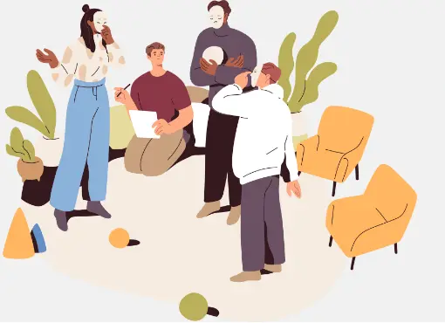
E.g.: a researcher interested in learning about the study habits of college students might visit a campus coffee shop or library to observe their behavior. They might note the number of students who study in these locations, the time of day most students prefer to study, whether the students prefer to study in groups or alone and how long their study sessions tend to last. To participate more directly, the researcher may ask to join a weekly study group and assess how the students interact in each meeting during the semester.

Slide 32

Case Studies
To do a case study, the researcher focuses on a single event, situation, or individual. The purpose is to understand the dynamics of relationships and power or even the thinking that motivates people.
Case studies reveals a lot of detail about some particular situation, but there is the problem of generalizability, which plagues case studies, is the primary reason that few sociologists use this method.
For example, Sociologist Ken Levi (1981/2016), wanted to study hit men. But he had access to only one. He interviewed this man over and over, giving us an understanding of how someone can kill others for money.
For spouse abuse, a case study would focus on a single couple, exploring their history and relationship.

Slide 33
Experiments
The experimental research method is the exact opposite of participant observation. Instead of studying people as they are, experiments usually occur in a controlled environment. Experiments are ideal for investigating causal relationships between variables.
If this particular thing were to happen, then that particular thing will result. E.g.: A scientist studying how individuals subconsciously change their speech patterns when talking to someone they perceive as an authority figure.
There are two types of experimentation:
Laboratory experiments – take place in a location chosen by the sociologist. Researchers bring people or groups into the controlled environment and ask questions or play out scenarios to test their hypothesis.
Field experiments –happen in the “real world”—for example, in a workplace. Because sociologists can control fewer factors in the field, these experiments may have less precise data. Still, field experiments have the benefit of keeping participants in their “natural habitat”.

Slide 34
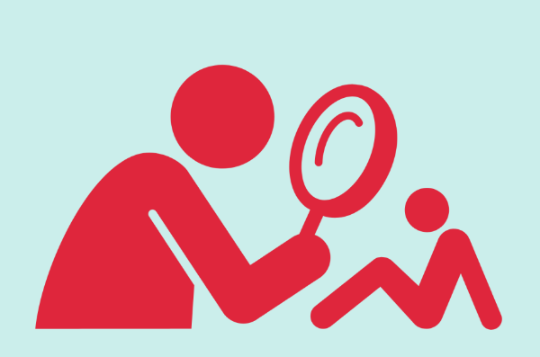
The Hawthorne Effect
Researchers need to be aware that subjects’ behavior may change simply because they are getting special attention, as one classic experiment revealed.
In the late 1930s, the Western Electric Company hired researchers to investigate worker productivity in its Hawthorne factory near Chicago (Roethlisberger & Dickson, 1939).
The experiment tested the hypothesis that increasing the available lighting would raise worker output. First, researchers measured worker productivity or output (the dependent variable). Then they increased the lighting (the independent variable) and measured output a second time. Productivity had gone up, a result that supported the hypothesis.
But when the research team later turned the lighting back down, productivity increased again. What was going on? The researchers concluded that the employees were working harder (even if they could not see as well) simply because people were paying attention to them and measuring their output.
Although this conclusion has been called into question by the results of later research, social scientists still use the term Hawthorne effect to refer to a change in a subject’s behavior caused simply by the awareness of being studied (Leavitt & List, 2009).

Slide 35

Secondary Analysis
The analysis of data already collected by other researchers. Used when resources are limited and/or existing data may provide excellent sources of information.
By consulting past reports, studies, videos, images and books, sociologists can better understand their research topic. E.g.: A researcher conducting a meta-analysis that analyzes every study on the academic achievement of third-grade students in New York City within the last 10 years.
Researchers often prefer primary data, so they only turn to secondary analysis when:
Existing data is already of high quality
Travel or large-scale study is costly or logistically impossible
More context is needed
A meta-analysis (cross-study) is to be performed
Dealing with secondary sources demands extra care and attention. When data isn’t primary, there can be no way to confirm the accuracy or lack of bias.

Slide 37

Ethics in Sociological Research

Slide 38
American Sociological Association (ASA) has established formal guidelines for conducting research (1997).
Research ethics require honesty, truth, and openness, (sharing findings with the scientific community).
They must disclose all research findings without omitting significant data. They should make their results available to other sociologists who may want to conduct a similar study. Ethics clearly forbid the falsification of results, as well as plagiarism (stealing someone else’s work).
Generally, people should be informed that they are being studied. Researchers must get the informed consent of participants, which means that the subjects must understand the responsibilities and risks that the research involves before agreeing to take part.
Sociologists must stop their work right away if they suspect that any subject is at risk of harm.

Slide 39
Researchers are also required to protect the privacy of anyone involved in a research project, even if they come under pressure from authorities, such as the police or the courts, to release confidential information. Sometimes people reveal things that are intimate, potentially embarrassing, or otherwise harmful to themselves or others.
Sociologists must reveal in their published results the sources of all financial support. They must avoid accepting money from a source if there is any question of a conflict of interest. For example, researchers must never accept funding from any organization that seeks to influence the research results for its own purposes.
The federal government also plays a part in research ethics. Colleges and universities that seek federal funding for research involving human subjects must have an institutional review board (IRB) to review grant applications and ensure that research will not violate ethical standards.
There are global dimensions to research ethics. Before beginning research in another country, an investigator must become familiar enough with that society to understand what people there are likely to regard as a violation of privacy or a source of personal danger.

Slide 40
Case - Protecting the Subjects (Mario Brajuha)
Research Mario Brajuha, a graduate student at the State University of New York at StonyBrook, was doing participant observation of restaurant workers.
He lost his job as a waiter when the restaurant where he was working burned down—a fire of “suspicious origin,” as the police said. When detectives learned that Brajuha had taken field notes they asked to see them.
Because he had promised to keep the information confidential, Brajuha refused to hand them over. The district attorney then threatened to put Brajuha in jail. By this time, Brajuha’s notes had become rather famous, and unsavory characters—perhaps those who had set the fire—also wanted to know what was in them.
For two years, Brajuha refused to hand over his notes, even though he grew anxious and had to appear at several court hearings. Finally, the district attorney dropped the subpoena. When the two men under investigation for setting the fire died, the threats to Brajuha, his wife, and their children ended.
Notes:
Source: the course book, Sociology-A Down-to-Earth Approach- 13th edition by James. M. Henslin,

Slide 41
